Slide 1
Naïve bayes

Slide 2
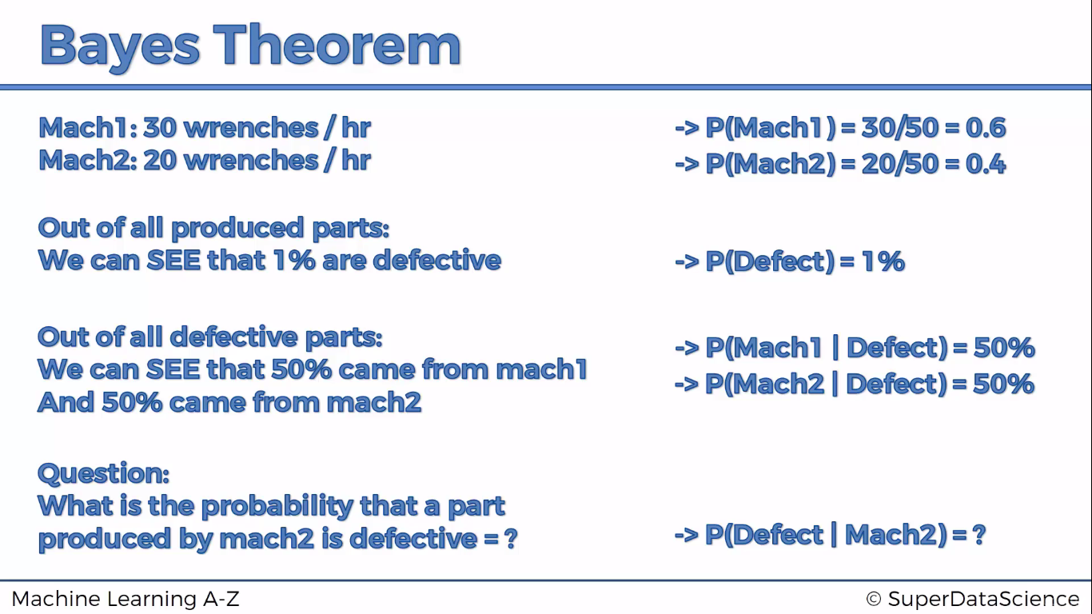

Slide 3
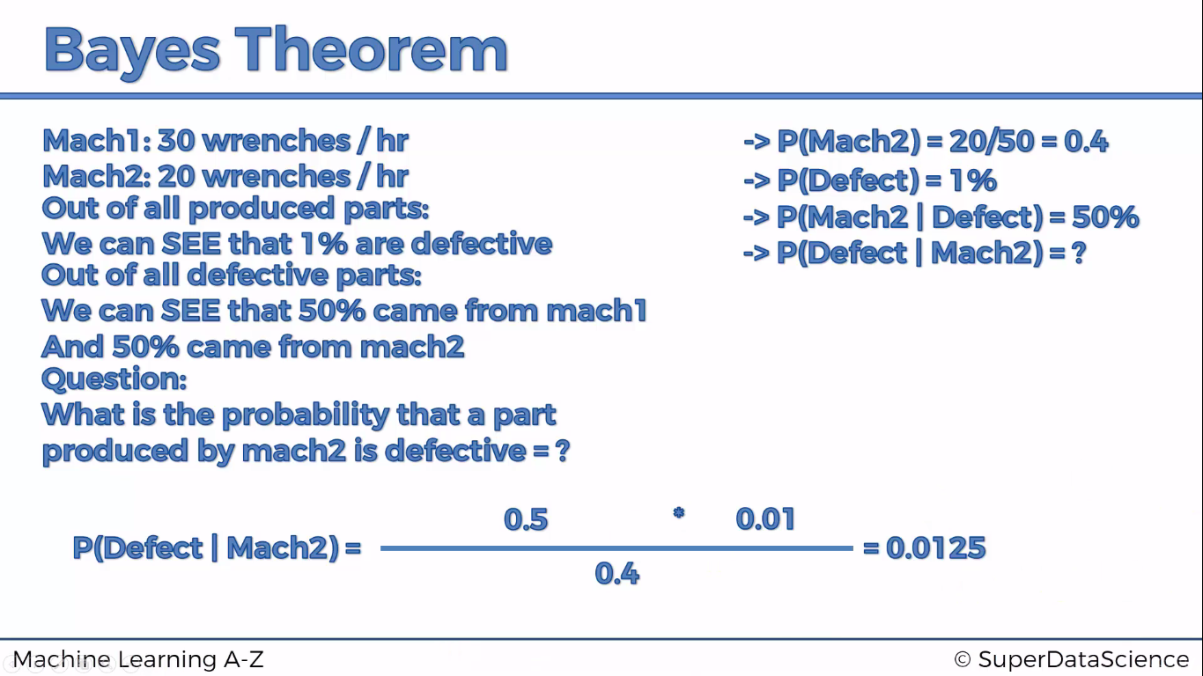

Slide 4
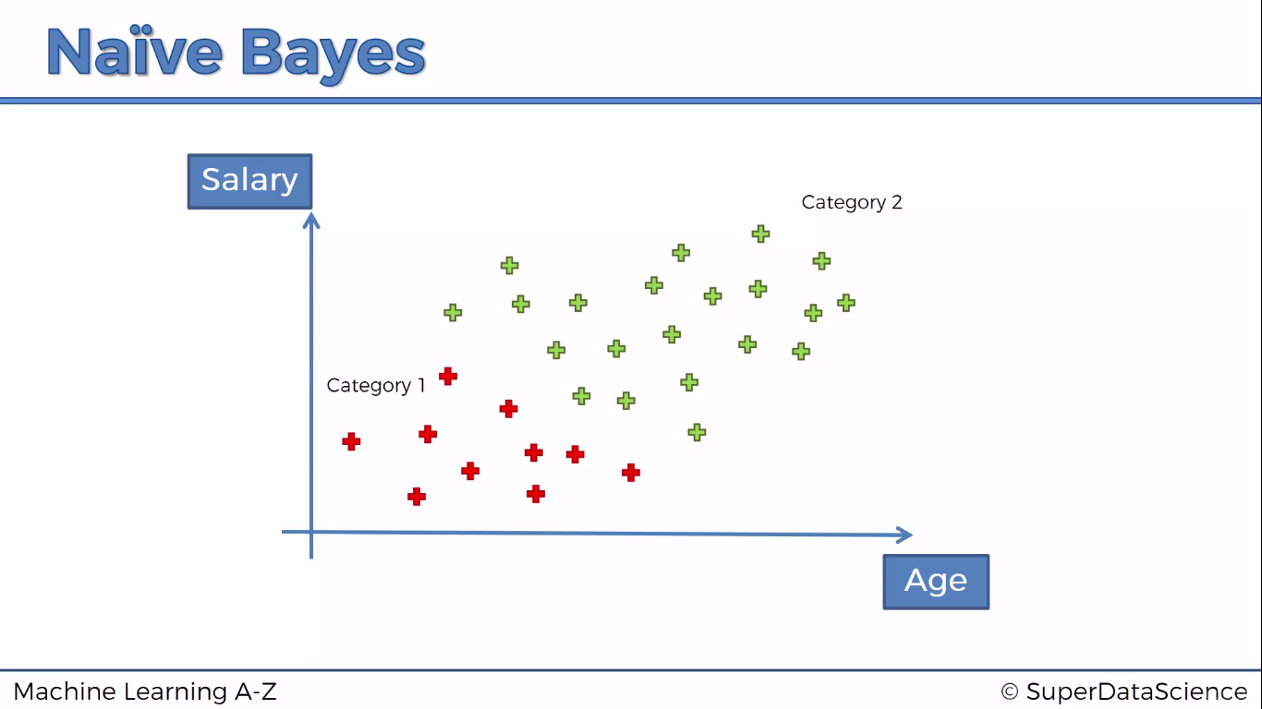

Slide 5
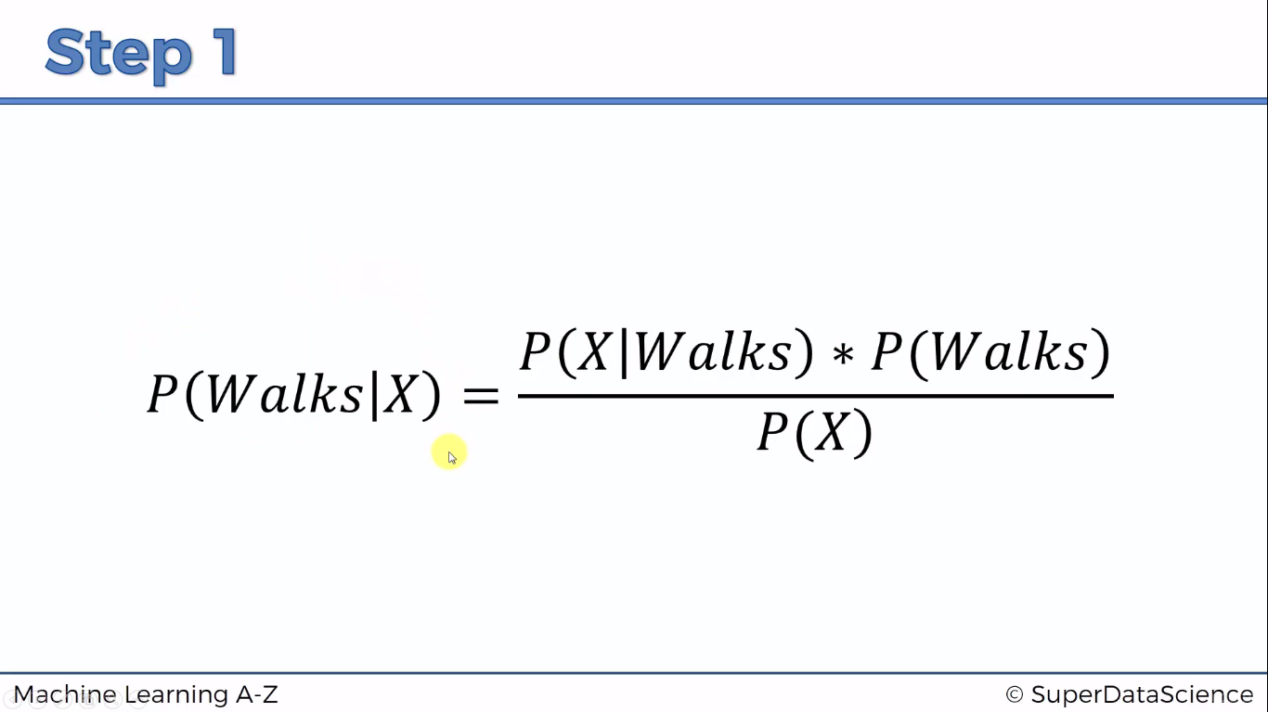

Slide 6
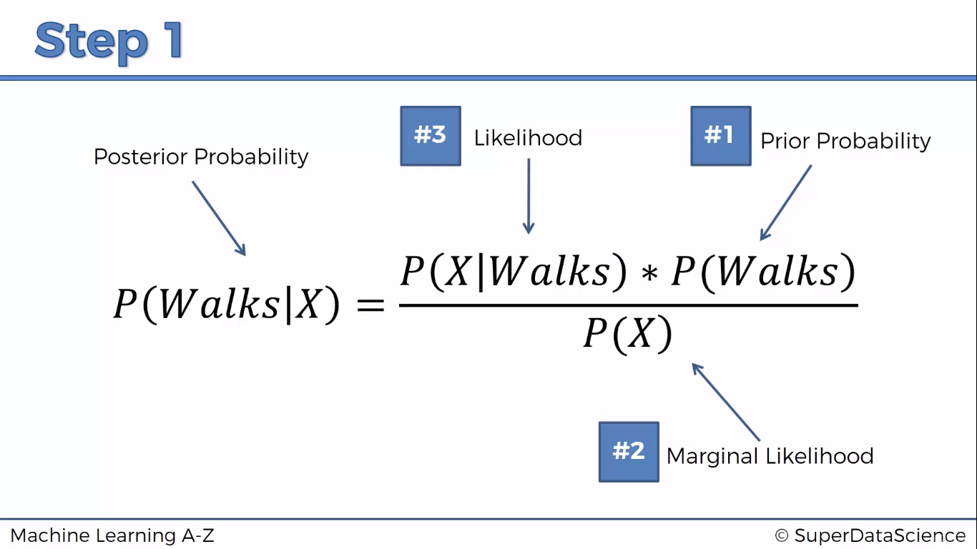

Slide 7
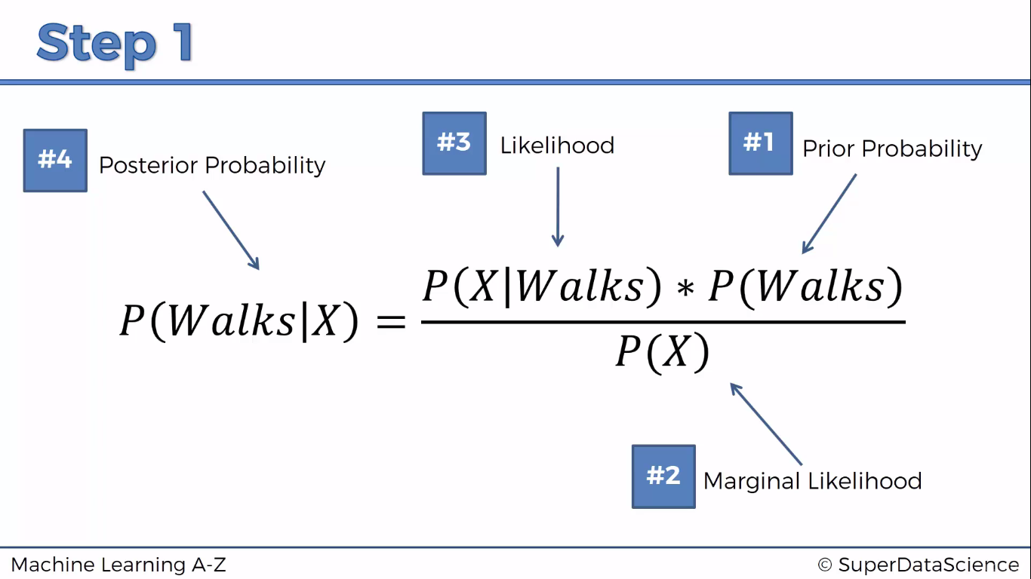

Slide 8
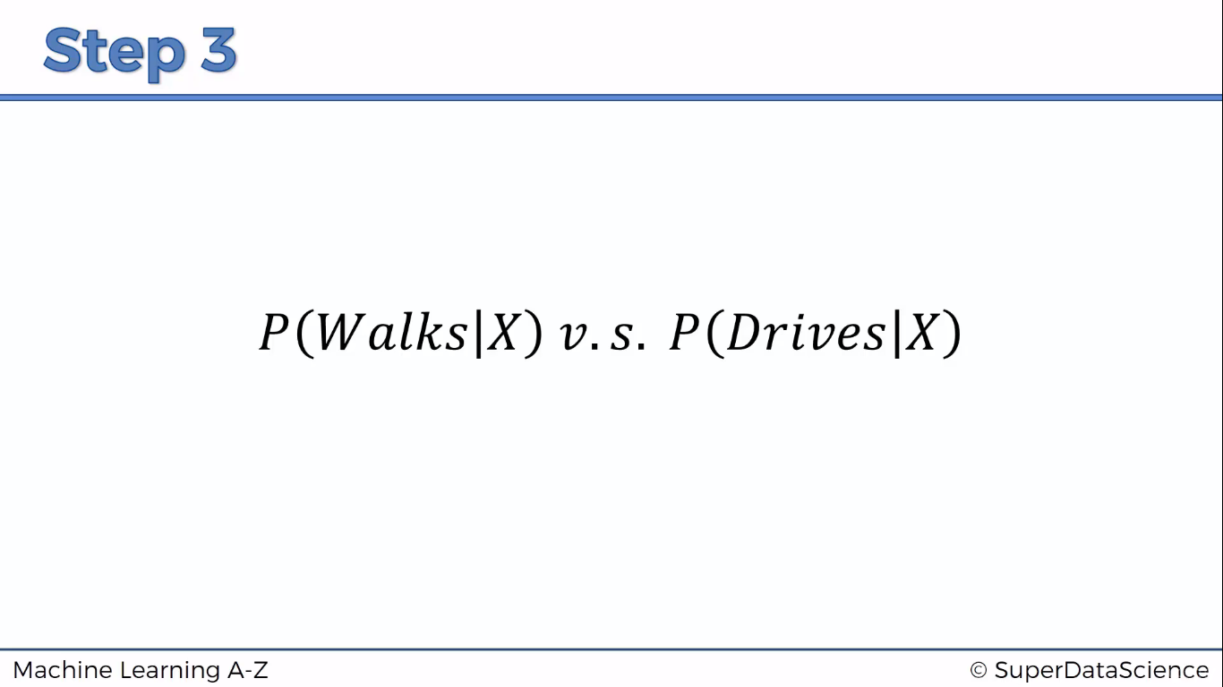

Slide 9
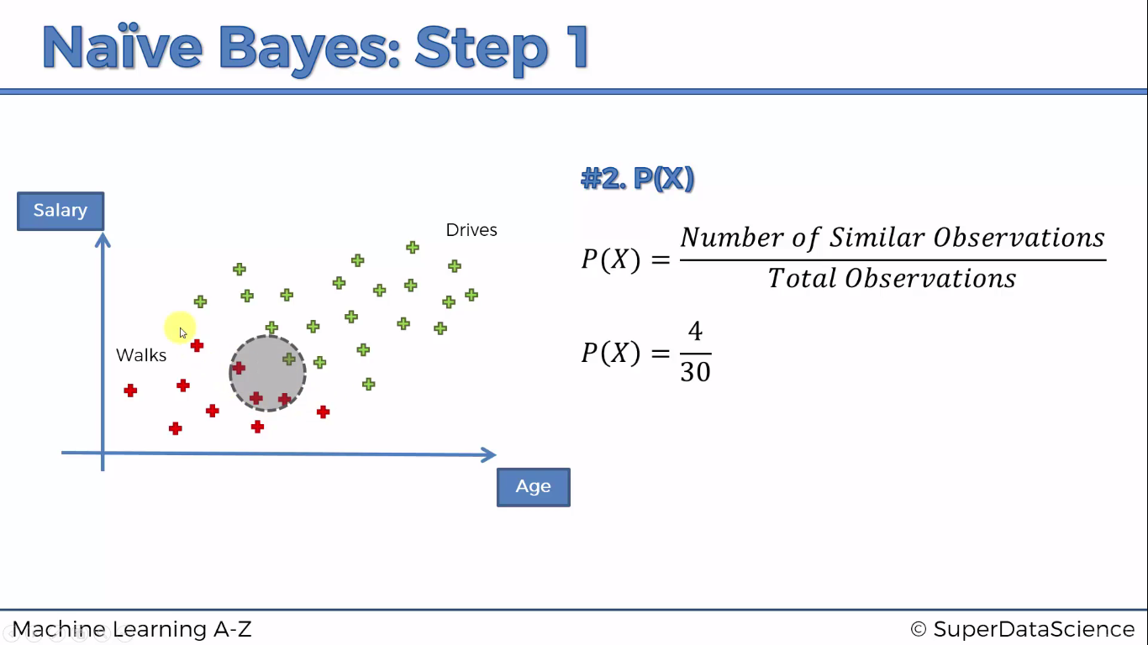

Slide 10
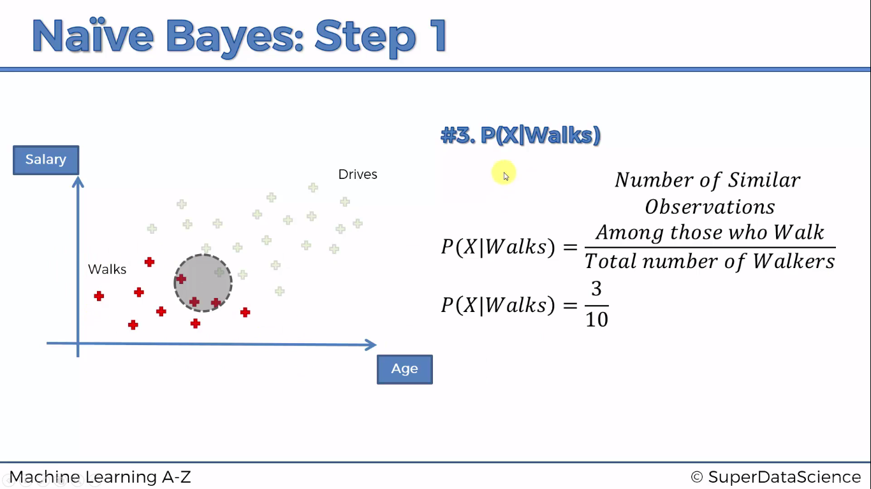

Slide 11
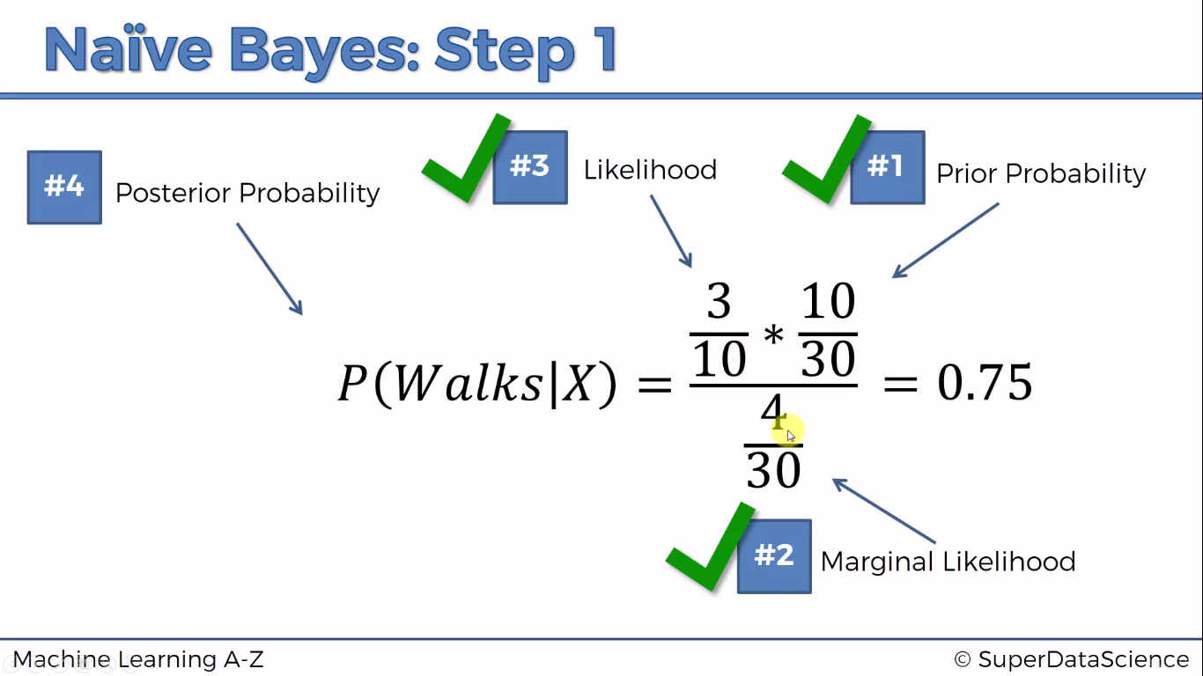

Slide 12

Python

Slide 13
Reading dataset dynamically
from tkinter import *
from tkinter.filedialog import askopenfilename
root = Tk()
root.withdraw()
root.update()
file_path = askopenfilename()
root.destroy()

Slide 14
Importing Libraries
import pandas as pd
import numpy as np
import matplotlib.pyplot as plt

Slide 15
Importing dataset
dataset = pd.read_csv('Social_Network_Ads.csv')
X = dataset.iloc[:,2:4]
y= dataset.iloc[:,-1]

Slide 16
Splitting the dataset into the Training set and Test set
from sklearn.cross_validation import train_test_split
X_train, X_test, y_train, y_test = train_test_split(X, y, test_size = 0.25, random_state = 0)

Slide 17
Feature Scaling
from sklearn.preprocessing import StandardScaler
sc = StandardScaler()
X_train = sc.fit_transform(X_train)
X_test = sc.transform(X_test)

Slide 18
Feature Selection …
Recursive Feature Elimination (RFE) is based on the idea to repeatedly construct a model and choose either the best or worst performing feature, setting the feature aside and then repeating the process with the rest of the features.
This process is applied until all features in the dataset are exhausted. The goal of RFE is to select features.

Slide 19
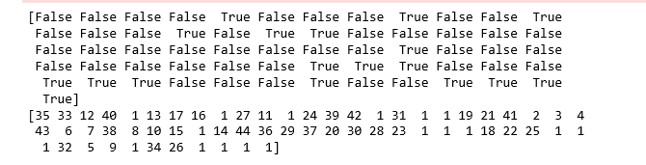
Feature Selection …
from sklearn import datasets
from sklearn.feature_selection import RFE
from sklearn.naive_bayes import GaussianNB
logreg = GaussianNB()
rfe = RFE(logreg, 2)
rfe = rfe.fit(X, y )
print(rfe.support_)

Slide 20
Naïve Bayes model
from sklearn.naive_bayes import GaussianNB
classifier = GaussianNB()
model = classifier.fit(X_train,y_train)
# Predicting the Test set results
y_pred = classifier.predict(X_test)

Slide 21
Confusion Matrix
from sklearn.metrics import confusion_matrix
cm = confusion_matrix(y_test, y_pred)

Slide 22
K fold
from sklearn import model_selection
from sklearn.model_selection import cross_val_score
kfold = model_selection.KFold(n_splits=10, random_state=7)
modelCV = GaussianNB()
scoring = 'accuracy'
results = model_selection.cross_val_score(modelCV, X_train, y_train, cv=kfold, scoring=scoring)
print("10-fold cross validation average accuracy: %.3f" % (results.mean()))

Slide 23
Evaluating classification report
from sklearn.metrics import classification_report
print(classification_report(y_test, y_pred))

Slide 24

R

Slide 25
Read dataset
library(readr)
dataset <- read_csv("D:/machine learning AZ/Machine Learning A-Z Template Folder/Part 3 - Classification/Section 14 - Logistic Regression/Logistic_Regression/Social_Network_Ads.csv")
dataset = dataset[3:5]

Slide 26
Encoding the target feature as factor
dataset$Purchased = factor(dataset$Purchased, levels = c(0, 1))

Slide 27
Splitting the dataset into the Training set and Test set
# install.packages('caTools')
library(caTools)
set.seed(123)
split = sample.split(dataset$Purchased, SplitRatio = 0.75)
training_set = subset(dataset, split == TRUE)
test_set = subset(dataset, split == FALSE)

Slide 28
Feature scaling
training_set[-3] = scale(training_set[-3])
test_set[-3] = scale(test_set[-3])

Slide 29
Fitting Naïve bayes to the Training set
library(e1071)
classifier = naiveBayes(x = training_set[-3],
y = training_set$Purchased)

Slide 30
prediction
y_pred = predict(classifier, newdata = test_set[-3])

Slide 31
Confusion matrix
# Making the Confusion Matrix
cm = table(unlist(test_set[, 3]), y_pred )

